Slide 1
操作系统概念
Operating System Concepts
Silberschatz, Galvin and Gagne
王冬青
wang.box@163.com

Slide 2
内容框架
概述
体系结构
进程管理
内存管理
文件管理
外设管理

Slide 3
内容
Ch2: 计算机体系结构
Ch3: 操作系统体系结构

Slide 4
ch3: Operating-System
Structures
OS Components
OS Services (for designers)
OS API (for programmers)
OS Apps (for application users)
OS Structure
Virtual Machines
OS Design

Slide 5
ch3: Operating-System
Structures
OS Components
OS Services (for designers)
OS API (for programmers)
OS Apps (for application users)
OS Structure
Virtual Machines
OS Design

Slide 6
OS Components
Process Management
Main Memory Management
Secondary-Storage Management
I/O System Management
File Management
Protection System
Networking
Command-Interpreter System

Slide 7
OS Components
Process Management
Main Memory Management
Secondary-Storage Management
I/O System Management
File Management
Protection System
Networking
Command-Interpreter System

Slide 8
Process Management
Process and Program
  A process(进程) is a program in execution.
  A process needs certain resources, including CPU time, memory, files, and I/O devices, to accomplish its task.
  A process is an active (活动) entity whereas a program is a passive (被动) entity.

Slide 9
Process Management
The operating system is responsible for the following activities in connection with process management.
  Process creation and deletion.
  process suspension and resumption.
  Provision of mechanisms for:
    process synchronization
    process communication
  Process deadlock handling.

Slide 10
Process Management
    进程控制：创建和撤销进程以及控制进
    程的状态
    进程同步：协调、互斥访问临界资源，
    协调执行进程
    进程通信：进程间的消息交换
    进程调度：按一定算法从进程就绪队列
    中选一个进程去执行

Slide 11
OS Components
Process Management
Main Memory Management
Secondary-Storage Management
I/O System Management
File Management
Protection System
Networking
Command-Interpreter System

Slide 12
Main Memory Management
Memory is a large array of words or bytes, each with its own address.
It is a repository of quickly accessible data shared by the CPU and I/O devices.
Main memory is a volatile storage device. It loses its contents in the case of system failure.

Slide 13
Main Memory Management
The operating system is responsible for the following activities in connections with memory management:
  Keep track of which parts of memory are currently being used and by whom.
  Decide which processes to load when memory space becomes available.
  Allocate and deallocate memory space as needed.

Slide 14
Main Memory Management
    为多道程序的并发执行提供良好的环境：
    便于用户使用存储器；
    提高存储器的利用率；
    为尽可能多的用户提供足够大的存储空间。

Slide 15
Main Memory Management
    内存分配：静态/动态分配、
    连续/非连续分配；
    内存保护：系统内存空间
    各用户内存空间
    地址映射：逻辑地址→物理地址
    内存扩展：虚拟存储技术

Slide 16
OS Components
Process Management
Main Memory Management
Secondary-Storage Management
I/O System Management
File Management
Protection System
Networking
Command-Interpreter System

Slide 17
Secondary-Storage Management
Since main memory (primary storage内存) is volatile and too small to accommodate all data and programs permanently, the computer system must provide secondary storage(外存) to back up main memory.
Most modern computer systems use disks as the principle on-line storage medium, for both programs and data.

Slide 18
Secondary-Storage Management
The operating system is responsible for the following activities in connection with disk management:
  Free space management
  Storage allocation
  Disk scheduling

Slide 19
OS Components
Process Management
Main Memory Management
Secondary-Storage Management
I/O System Management
File Management
Protection System
Networking
Command-Interpreter System

Slide 20
I/O System Management
I/O System Management
  Too many I/O devices to mention.
  The OS is designed to hide the peculiarities of specific hardware devices from the user.
  ---HAL(Hardware Abstract Layer)
  The I/O system consists of:
    A buffer-caching system
    A general device-driver interface
    Drivers for specific hardware devices

Slide 21
I/O System Management
    为用户程序分配I/O设备；
    完成用户程序请求的I/O操作；
    提高处理机和I/O设备的利用率；
    改善人机界面

Slide 22
I/O System Management
    缓冲管理
    设备管理
    设备处理：启动、中断
    虚拟设备
    RAID技术、磁盘调度

Slide 23
OS Components
Process Management
Main Memory Management
Secondary-Storage Management
I/O System Management
File Management
Protection System
Networking
Command-Interpreter System

Slide 24
File Management
File Management
  The OS provides a uniform logical view of information storage. (Many different types of physical media.)
  A file is a collection of related information defined by its creator. File contents, file formats, file structures, file attributes.
  Files are organized into directories.

Slide 25
File Management
The operating system is responsible for the following activities in connections with file management:
  File creation and deletion.
  Directory creation and deletion.
  Support of primitives for manipulating files and directories.
  Mapping files onto secondary storage.
  File backup on stable (nonvolatile) storage media.

Slide 26
File Management
    管理用户文件和系统文件
    管理文件的存储空间
    保证文件数据的安全
    方便用户使用文件

Slide 27
File Management
    文件目录管理
    文件的逻辑组织与访问方式
    存储空间的管理：文件的物理组织
    空闲磁盘空间管理
    文件共享与安全

Slide 28
OS Components
Process Management
Main Memory Management
Secondary-Storage Management
I/O System Management
File Management
Protection System
Networking
Command-Interpreter System

Slide 29
Protection System
A computer system has multiple users and processes.
Protection refers to a mechanism for controlling access by programs, processes, or users to both system and user resources.
Protection mechanism must provide
  means for specification of the controls to be imposed,
  means for enforcement.

Slide 30
OS Components
Process Management
Main Memory Management
Secondary-Storage Management
I/O System Management
File Management
Protection System
Networking
Command-Interpreter System

Slide 31
Networking
A distributed system is a collection processors that do not share memory or a clock. Each processor has its own local memory.
The processors in the system are connected through a communication network.
A distributed system provides user access to various system resources.

Slide 32
Networking
Access to a shared resource allows:
  Computation speed-up
  Increased data availability
  Enhanced reliability
  Communication (WWW, BBS……)
OS networking management activities
  Network protocols (TCP/IP),
  Network device drivers (Physical layer and data link layer).

Slide 33
OS Components
Process Management
Main Memory Management
Secondary-Storage Management
I/O System Management
File Management
Protection System
Networking
Command-Interpreter System

Slide 34
Command-Interpreter System
Command-interpreter is the interface between the user and the operating system. Character-based and GUI-based interpreters.
Many commands are given to the operating system by control statements which deal with:
    process creation and management
    I/O handling
    secondary-storage management
    main-memory management
    file-system access
    protection
    networking

Slide 35
Command-Interpreter System
Touchscreen devices require new interfaces
Mouse not possible or not desired
Actions and selection based on gestures(手势)
Virtual keyboard for text entry
Voice commands.

Slide 36
ch3: Operating-System
Structures
OS Components
OS Services (for designers)
OS API (for programmers)
OS Apps (for application users)
OS Structure
Virtual Machines
OS Design

Slide 37
OS Services
Basic services
  Program execution
  system capability to load a program into memory and to run it.
  I/O operations
  since user programs cannot execute I/O operations directly, the operating system must provide some means to perform I/O.
  File-system manipulation
  program capability to read, write, create, and delete files.

Slide 38
OS Services
Communications
exchange of information between processes executing either on the same computer or on different systems tied together by a network. Implemented via shared memory or message passing.
Error detection
ensure correct computing by detecting errors in the CPU and memory hardware, in I/O devices, or in user programs.

Slide 39
OS Services
Additional functions
Additional functions exist not for helping the user, but rather for ensuring efficient system operations.
  Resource allocation
  allocating resources to multiple users or multiple jobs running at the same time.

Slide 40
OS Services
Accounting
keep track of and record which users use how much and what kinds of computer resources for account billing or for accumulating usage statistics.
Protection
ensuring that all access to system resources is controlled.

Slide 41
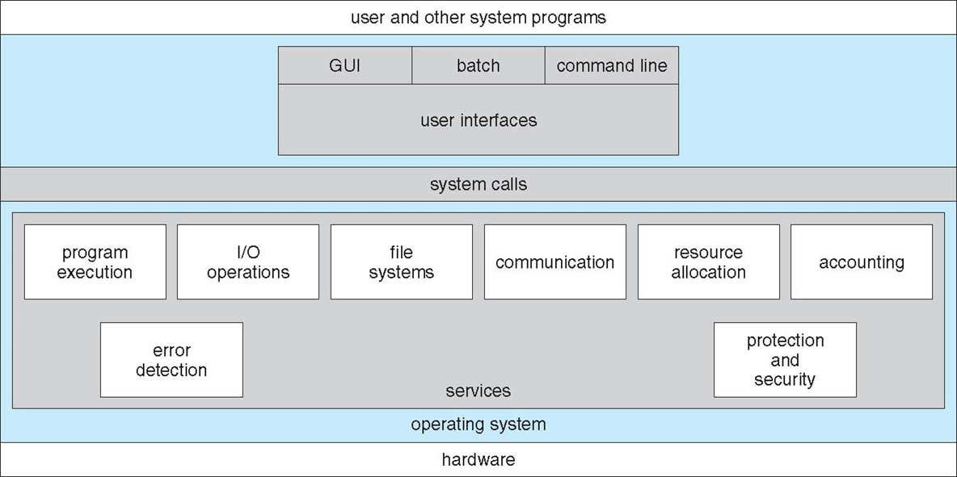
OS Services
Kernel

Slide 42
ch3: Operating-System
Structures
OS Components
OS Services (for designers)
OS API (for programmers)
OS Apps (for application users)
OS Structure
Virtual Machines
OS Design

Slide 43
OS API(System Call)
System calls provide the interface between a running program and the operating system.
  Generally available as assembly-language instructions.
  Languages defined to replace assembly language for systems programming allow system calls to be made directly . (e.g., C, C++, Perl)

Slide 44
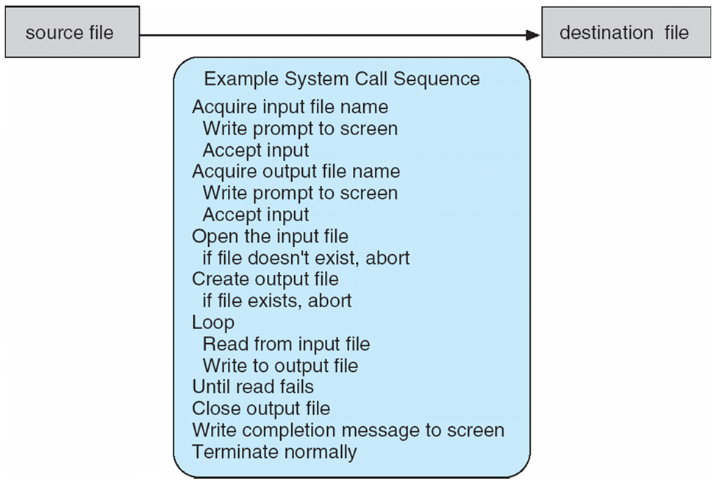
System Calls
An example of using system class: copy file1 file2.
  How to provide file names,
  How to prepare files for input and output,
  How to enter the loop,
  How to release the resources.

Slide 45

System Calls
用户程序调用open()

Slide 46
System Calls
Three general methods are used to pass parameters between a running program and the operating system.( 参数传递的方法 )
  Pass parameters in registers.
  Push (store) the parameters onto the stack by the program, and pop off the stack by operating system.
  Store the parameters in a table in memory, and the table address is passed as a parameter in a register. (linux) (see the next slide)

Slide 47

Passing of Parameters As A Table

Slide 48
System Calls
Types of system calls
  Process control –– 进程控制
  File management –– 文件管理
  Device management –– 设备管理
  Information maintenance –– 信息维护
  Communications –– 通信
  Linux：/usr/include/asm/unistd.h（分32位和64位）

Slide 49
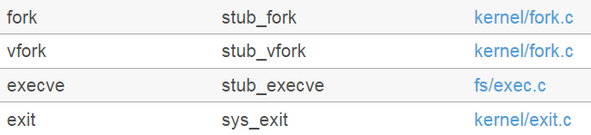
System Calls：
Process control
Create and terminate processes:
fork, exit.
Execute processes:
exec.
Get/set process attributes.
Abort, end processes.
Wait for time, wait for event, signal event.
Allocate and free memory.

Slide 50
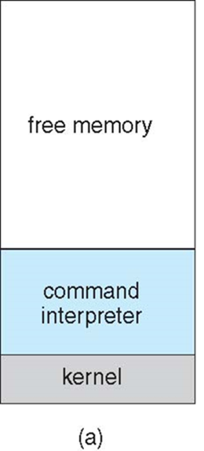
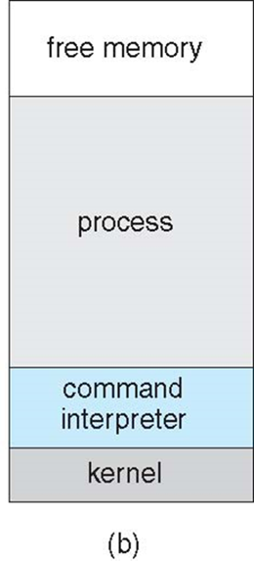
System Calls：
Process control
At system startup
running a program
MS-DOS

Slide 51
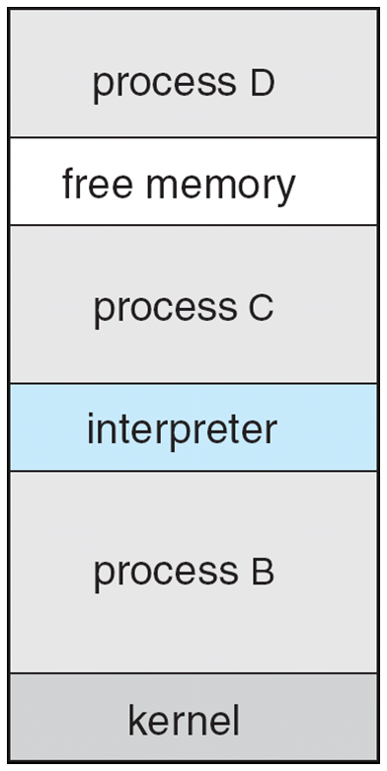
System Calls：
Process control
多任务系统

Slide 52
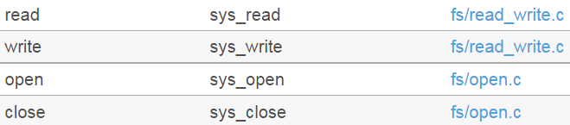
System Calls：
File management
Create file, delete file.
Open, close.
Read, write, reposition.
Get/set file attributes.
Similar operations for directories.

Slide 53
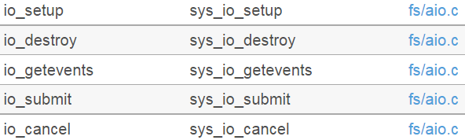
System Calls：
Device management
Request/release device
Read, write, reposition.
Get/set device attributes.
Logically attach or detach devices.

Slide 54
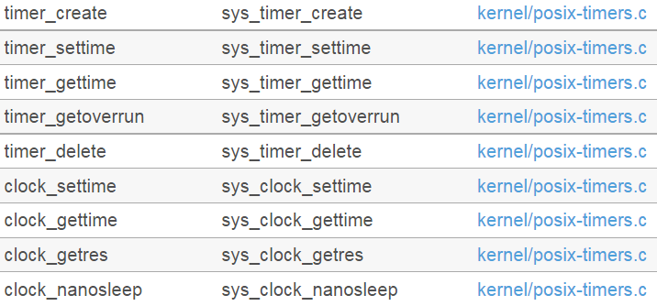
System Calls：
Information maintenance
Get time or date, set time or date.
Get system data, set system data.
Get process, file or device attributes.
Set process, file or device attributes.

Slide 55
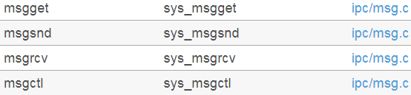
System Calls：
Communication
Create, delete communication connection.
Send, receive messages.
Transfer status information.
Attach or detach remote devices.

Slide 56
System Calls：
Communication
消息传递
共享内存
管道
socket

Slide 57

System Calls：
Communication
消息传递
共享内存

Slide 58
System Calls：
Communication
 | Windows | Unix
Process | CreateProcess() | fork()
Control | ExitProcess() | exit()
 | WaitForSingleObject() | wait()
File | CreateFile() | open()
Manipulation | ReadFile() | read()
 | WriteFile() | write()
 | CloseHandle() | close()
Device | SetConsoleMode() | ioctl()
Manipulation | ReadConsole() | read()
 | WriteConsole() | write()
Information | GetCurrentProcessID() | getpid()
Maintenance | SetTimer() | alarm()
 | Sleep() | sleep()
Communication | CreatePipe() | pipe()
 | CreateFileMapping() | shmget()
 | MapViewofFile() | mmap()
Protection | SetFileSecurity() | chmod()
 | InitializeSecurityDescriptor() | umask()
 | SetSecurityDescriptorGroup() | chown()

Slide 59
ch3: Operating-System
Structures
OS Components
OS Services (for designers)
OS API (for programmers)
OS Apps (for application users)
OS Structure
Virtual Machines
OS Design

Slide 60
OS SYSTEM PROGRAMS
System programs provide a convenient environment for program development and execution.
System programs:
  File manipulation; File modification.
  Status information.
  Programming language support; Program loading and execution.
  Communications.
  Application programs.

Slide 61
OS SYSTEM PROGRAMS
The most important system program: command interpreter.
The command interpreter
  can contain code segments,
  or invoke utilities to execute commands.
Most users’ view of the operation system is defined by system programs, not the actual system calls.

Slide 62
ch3: Operating-System
Structures
OS Components
OS Services (for designers)
OS API (for programmers)
OS Apps (for application users)
OS Structure
Virtual Machines
OS Design

Slide 63
System Structure
Simple Approach
Monolithic Kernel
Layer Structure
Microkernel

Slide 64
System Structure
Simple Approach（简单结构）
Monolithic Kernel
Layer Structure
Microkernel

Slide 65
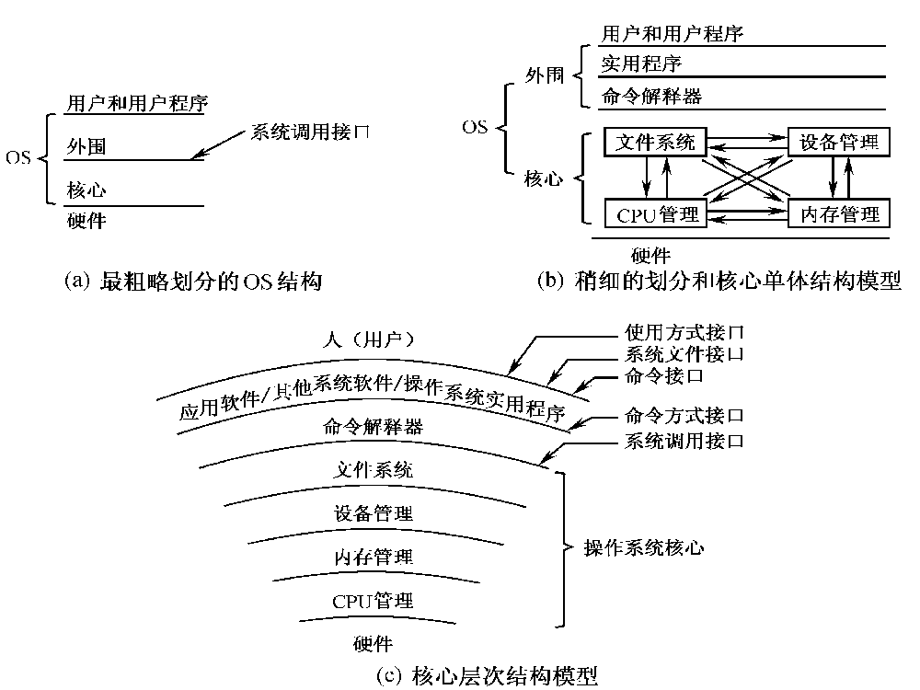

Slide 66
简单内核
Simple Approach
  MS-DOS – written to provide the most functionality in the least space
    not divided into modules
    Although MS-DOS has some structure, its interfaces and levels of functionality are not well separated

Slide 67
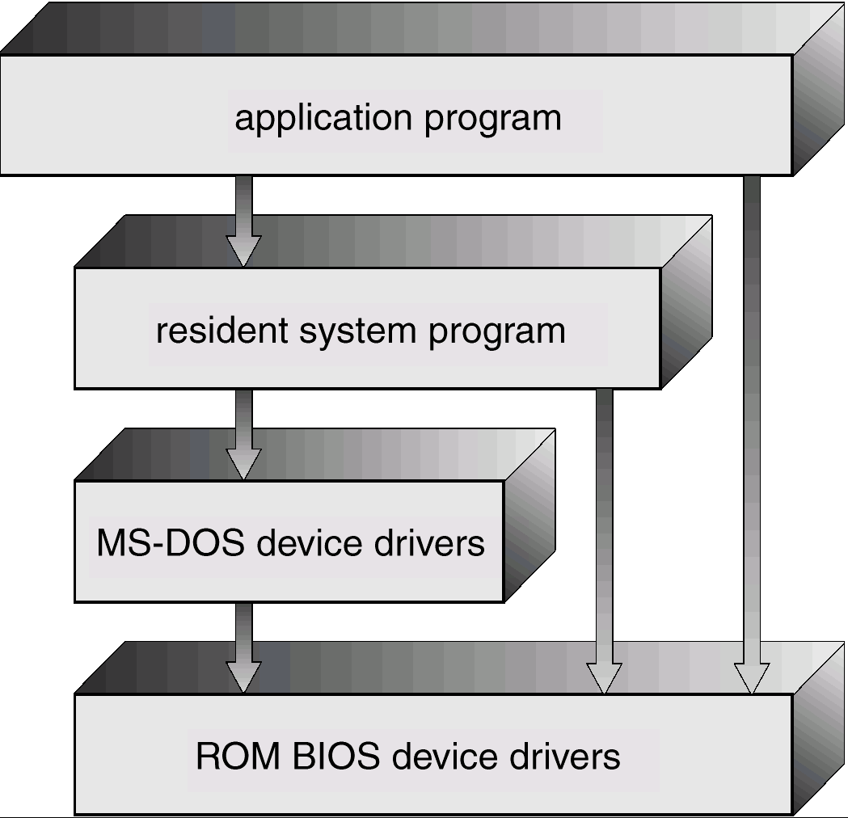
MS-DOS Structure

Slide 68
System Structure
Simple Approach
Monolithic Kernel（宏内核）
Layer Structure
Microkernel

Slide 69
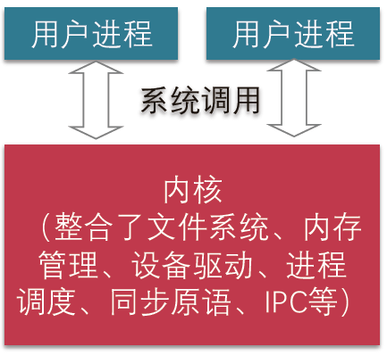
宏内核

Slide 70
宏内核
UNIX
limited by hardware functionality, the original UNIX operating system had limited structuring. The UNIX OS consists of two separable parts.
  Systems programs
  The kernel
    Consists of everything below the system-call interface and above the physical hardware
    Provides the file system, CPU scheduling, memory management, and other operating-system functions; a large number of functions for one level.

Slide 71
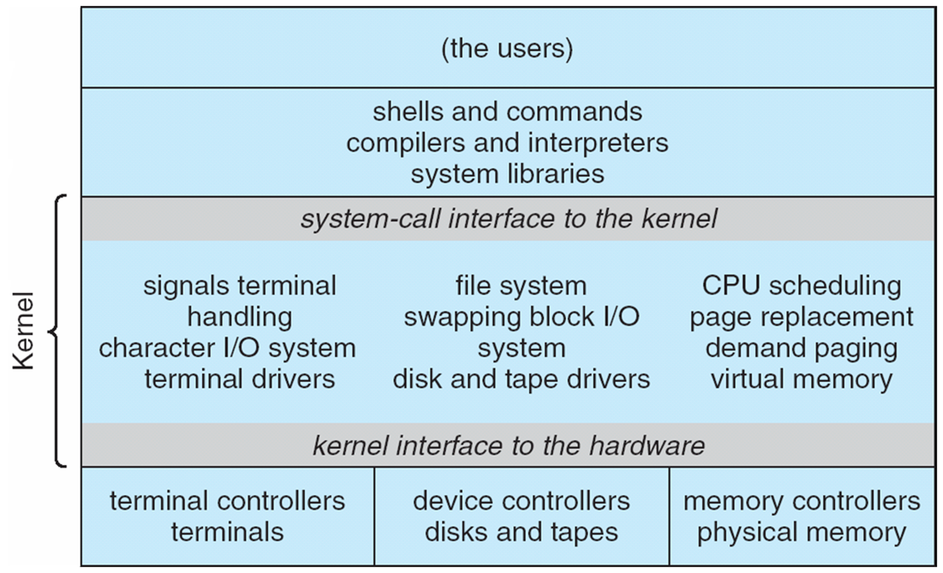
UNIX System Structure

Slide 72
宏内核
宏内核优点
  丰富的技术积累和对不同场景的优化
  巨大的统一社区和生态
宏内核缺陷
  安全性和可靠性：模块间没有很好的隔离机制
  实时性差：太复杂而无法做最坏情况下的时延分析
  庞大的结构阻碍创新

Slide 73
System Structure
Simple Approach
Monolithic Kernel
Layer Structure
Microkernel

Slide 74
分层结构
Layered Approach
  The operating system is divided into a number of layers (levels), each built on top of lower layers. The bottom layer (layer 0), is the hardware; the highest (layer N) is the user interface.
  With modularity, layers are selected such that each uses functions (operations) and services of only lower-level layers.

Slide 75
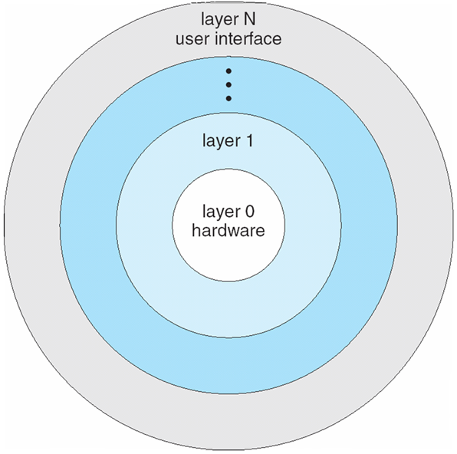
An Operating System Layer
分层结构

Slide 76
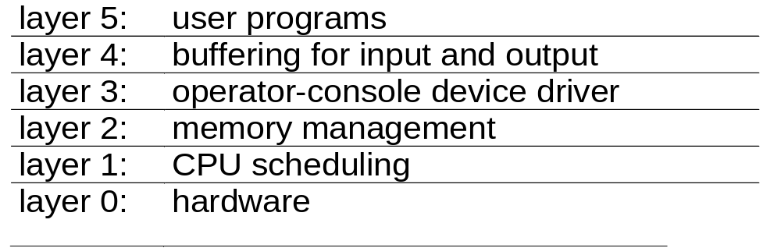
分层结构
A layered design was first used in THE operating system. Its six layers are as follows:

Slide 77
System Structure
Simple Approach
Monolithic Kernel
Layer Structure
Microkernel

Slide 78
System Structure
Microkernels
  Moves as much from the kernel into “user” space.
  Communication takes place between user modules using message passing.
  Benefits:
  - easier to extend a microkernel,
- easier to port the operating system to new architectures,
- more reliable (less code is running in kernel mode),
- more secure.

Slide 79
System Structure
Microkernels
  精心设计的、能实现现代OS核心功能的小型内核。不是一个完整操作系统，只是为构建通用OS提供基础。
  提供一些基本功能，如进程管理、存储器管理、进程间通信、低级I/O功能等
  现在微内核结构是以微内核为os核心，以客户/服务器为基础，采用面向对象程序设计特征。
  例如：Mach、MINIX，Google Fushsia的Zircon，QNX的Neutrno等都是微内核

Slide 80
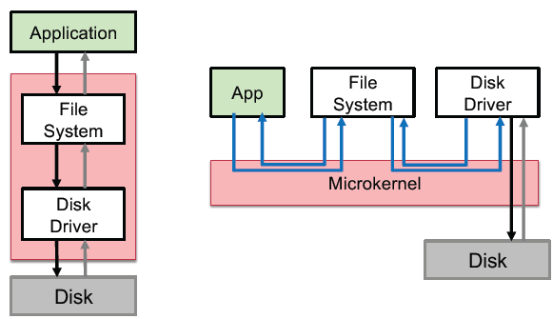
System Structure
例：文件的管理
系统服务

Slide 81
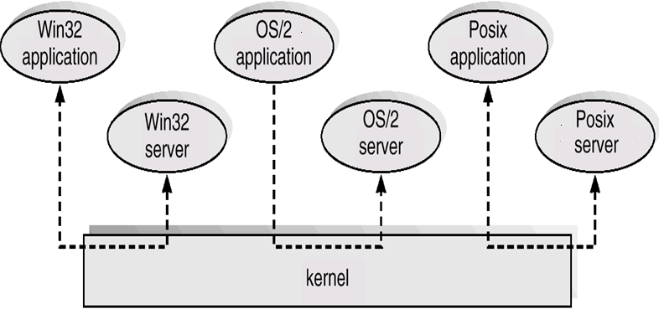
Windows NT Client-Server Structure
系统服务
消息传递

Slide 82
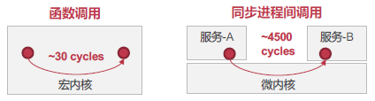
System Structure
微内核优点
  易于扩展、移植
  更可靠、安全、健壮
  微内核缺陷
  性能差
  生态和社区不够大
结论：进程间通讯要比系统调用慢

Slide 83
System Structure
拓展：
操作系统内核发展历史
  混合内核（Hybrid Kernel）
  外核（ExoKernel）
  多内核/复内核（Multi-Knernel）

Slide 84
ch3: Operating-System
Structures
OS Components
OS Services (for designers)
OS API (for programmers)
OS Apps (for application users)
OS Structure
Virtual Machines
OS Design

Slide 85
Virtual Machines
  A virtual machine takes the layered approach to its logical conclusion. It treats hardware and the operating system kernel as though they were all hardware.
  A virtual machine provides an interface identical to the underlying bare hardware.
  The operating system creates the illusion of multiple processes, each executing on its own processor with its own (virtual) memory.

Slide 86
Virtual Machines
The resources of the physical computer are shared to create the virtual machines.
  CPU scheduling can create the appearance that users have their own processor.
  Spooling and a file system can provide virtual card readers and virtual line printers.
  A normal user time-sharing terminal serves as the virtual machine operator’s console.

Slide 87
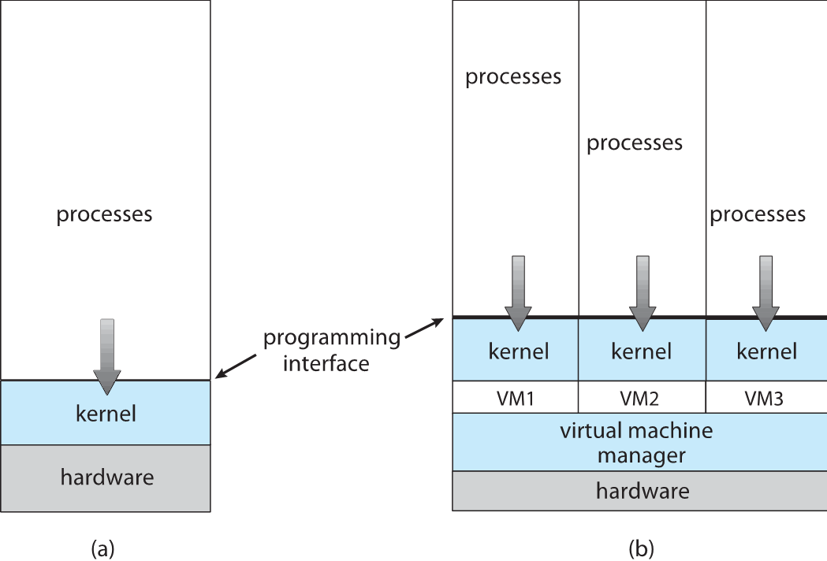
Non-virtual Machine
Virtual Machine

Slide 88
Virtual Machines：Implementation
Modes:
  virtual user mode and virtual monitor mode,
  Actual user mode and actual monitor mode
Time
  Whereas the real I/O might have taken 100 milliseconds, the virtual I/O might take less time (because it is spooled) or more time (because it is interpreted.)
  The CPU is being multi-programmed among many virtual machines, further slowing down the virtual machines in unpredictable ways.

Slide 89
Virtual Machines
Advantages/Disadvantages
  The virtual-machine concept provides complete protection of system resources since each virtual machine is isolated from all other virtual machines. This isolation, however, permits no direct sharing of resources.

Slide 90
System Structure
A virtual-machine system is a perfect vehicle for operating-systems research and development. System development is done on the virtual machine, instead of on a physical machine and so does not disrupt normal system operation.
The virtual machine concept is difficult to implement due to the effort required to provide an exact duplicate to the underlying machine.

Slide 91
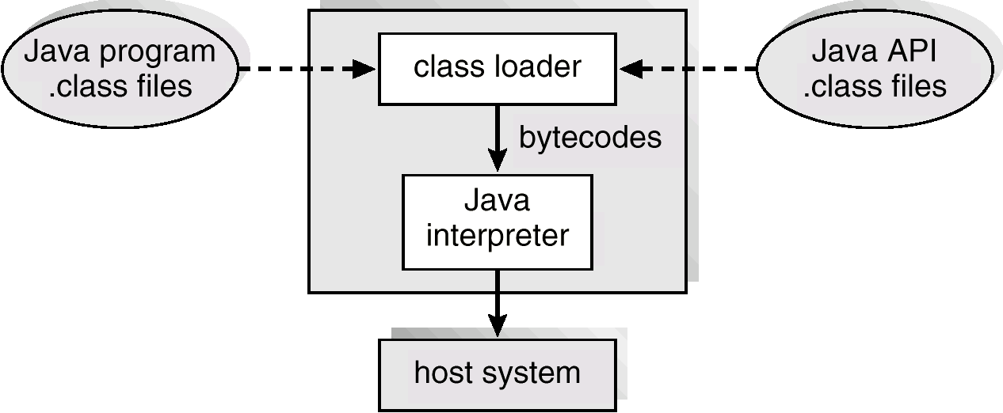
The Java Virtual Machine

Slide 92
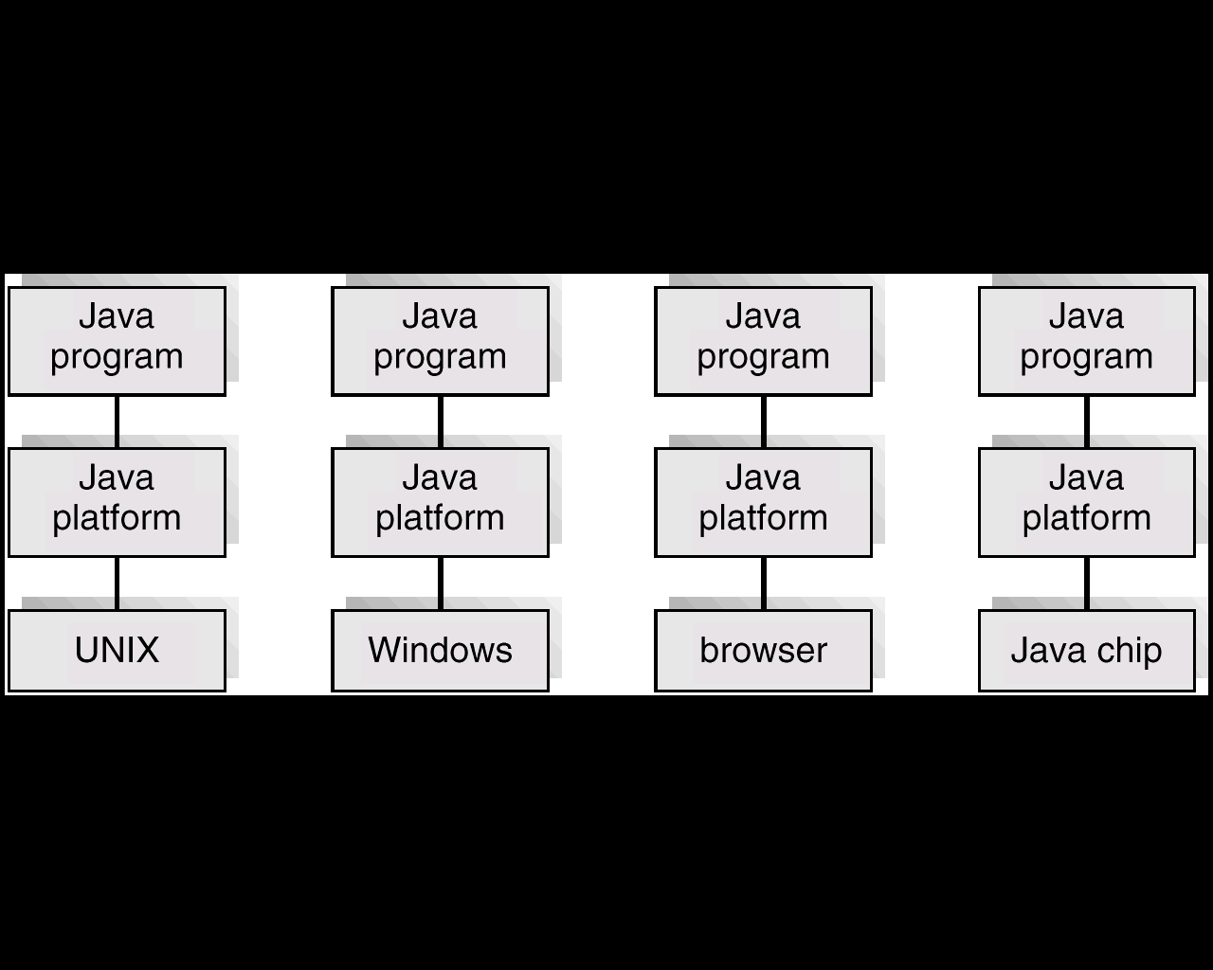
The Java Platform

Slide 93
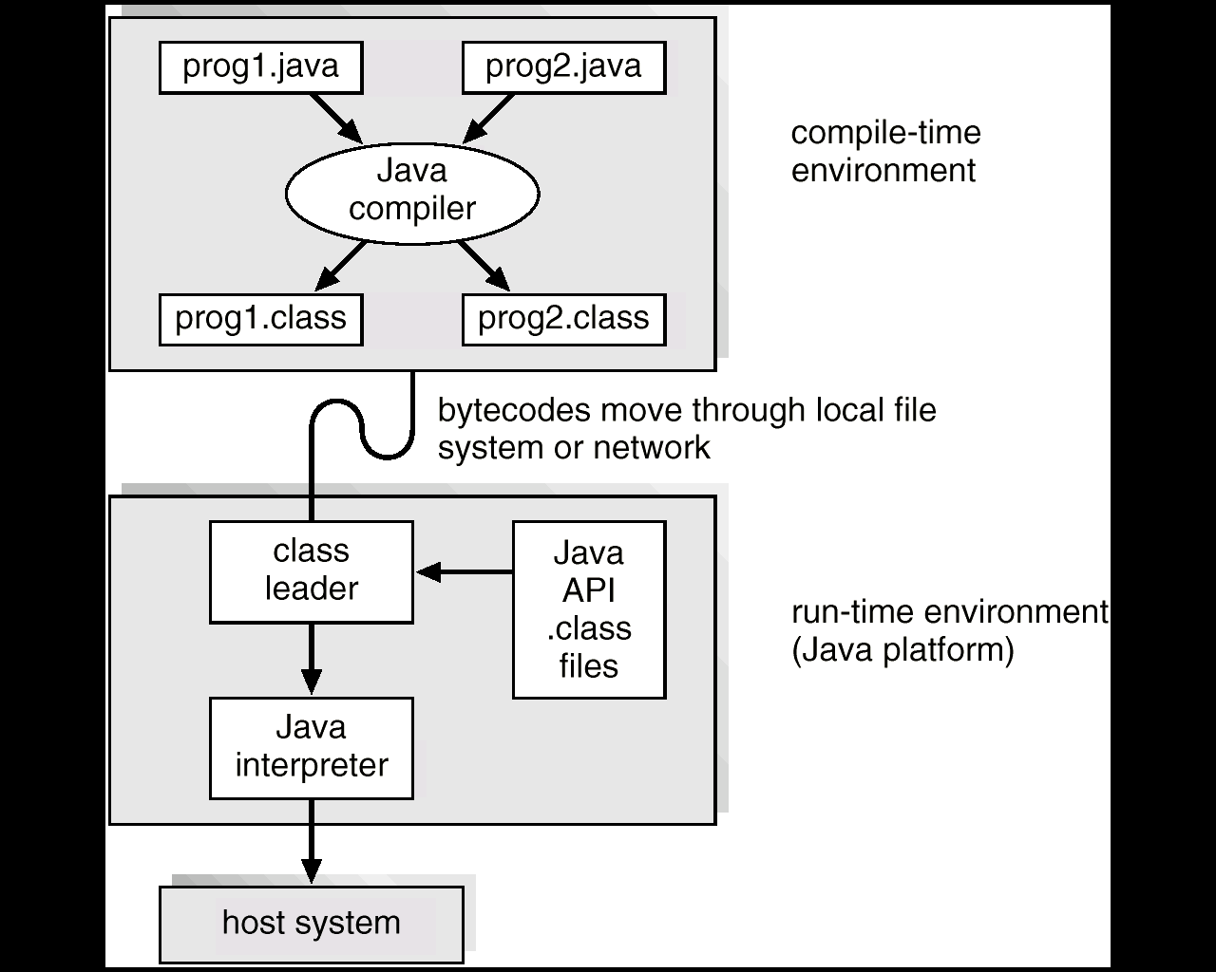
Java Development Environment

Slide 94
ch3: Operating-System
Structures
OS Components
OS Services (for designers)
OS API (for programmers)
OS Apps (for application users)
OS Structure
Virtual Machines
OS Design

Slide 95
System Design
Goals
Implementation

Slide 96
System Design
  System type: batch, time shared, single user, multi-user, distributed, real time, or general purpose
Goals
  User goals - operating system should be convenient to use, easy to learn, reliable, safe, and fast.
  System goals - operating system should be easy to design, implement, and maintain, as well as flexible, reliable, error-free, and efficient.

Slide 97
System Design
Goals
  可靠性
  可扩展性
  能效性
  安全性
  ……

Slide 98
Implementation
原则：策略（policy）与机制（mechanism）分离
  策略：做什么？（What）
  机制：如何做？（How）
  如优先级机制，定时机制，
优点
  灵活性
  可扩展性

Slide 99
Implementation
Much variation
Early O Ses in assembly language
Then system programming languages like Algol, P L/1
Now C, C++
Actually usually a mix of languages
Lowest levels in assembly
Main body in C
Systems programs in C, C++, scripting languages like P E R L, Python, shell scripts

Slide 100
Implementation
More high-level language easier to port（移植） to other hardware
But slower
Emulation（模拟器） can allow an O S to run on non-native hardware

Slide 101
小结
操作系统基本组件
操作系统结构
系统调用

